Slide 1
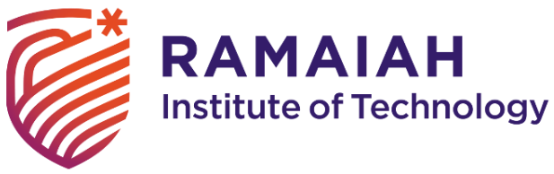
NetGuard IaC Analyzer
CSP67: Mini Project Work - Zeroth Review Presentation
Department of Computer Science and Engineering
Team:
1MS23CS200 – Trisha N Iyer
1MS23CS116 – Mohit Kumar Patwari
1MS23CS219 – Vineet Rajani
1MS24CS418 – Vinay J
Guide:
Dr S. Seema
Professor
CSE

Slide 2
Agenda
Problem Statement
Objective & Scope of the Proposed Project
Hardware & Software to be used
What contribution to society would the project make?
References

Slide 3
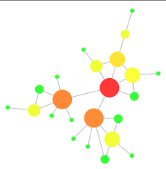
Introduction
Automated security scanning for infrastructure code
Scans Terraform and Kubernetes on pull requests
Builds network topology graphs before deployment
Visualizes security impact of infrastructure changes
Prevents misconfigurations from reaching production

Slide 4
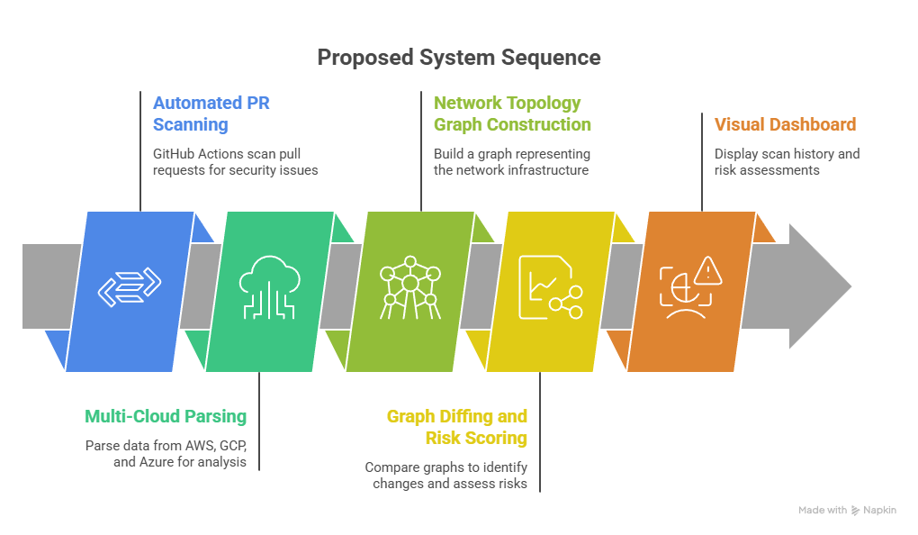
Problem Statement
Existing Tools:
Checkov — rule-based scanning, text output
Snyk IaC — commercial, rule violations only
Terrascan — open-source, text-based findings
tfsec — Terraform-focused, no visualization
Prisma Cloud — expensive, text reports
How Ours is Better:
Visual network topology graphs
PR-level graph diffing
Context-aware risk scoring
Developer-friendly visual feedback

Slide 5
Project Objectives
To design a multi-cloud parser supporting AWS, GCP, Azure, and Kubernetes
To build a network topology graph engine with 95%+ accuracy
To implement PR-level graph diffing detecting all exposure changes
To develop a risk scoring system with 4 severity levels
To create a visualization dashboard showing scan history and trends

Slide 6
SRS
Technologies Used
Python for backend parsing
FastAPI for REST API
React + Vite for frontend
NetworkX for graph operations
D3.js for graph visualization
Development Tools
VS Code or PyCharm IDE
GitHub for source control
Docker for containerization
Software Requirements
Python 3.11 or higher
Node.js 18+ and npm
Docker Desktop for containerization
PostgreSQL 14+

Slide 7
References
Bridgecrew. (2023). Checkov: Static code analysis for infrastructure as code. https://www.checkov.io/HashiCorp.
(2023). Terraform documentation.
https://www.terraform.io/docsIBM Security. (2023). Cost of a data breach report 2023.
IBM Corporation.NetworkX Developers. (2023).
NetworkX: Network analysis in Python. https://networkx.org/Palo Alto Networks. (2023).
Prisma Cloud: Cloud security platform. https://www.paloaltonetworks.com/prisma/cloudSnyk.
(2023). Snyk Infrastructure as Code: Security scanning for IaC. https://snyk.io/product/infrastructure-as-code-security/

Slide 8
Thank You

